Slide 1
Online Grocery Shopping System
Project Guide : Prof. Tanmoy Halder
Project Team | Role
1.Sumit Mukherjee (32301216011) | Coding, Design
2.Subhadip Chakraborty (32301216015) | Design, Testing
3. Subhadeep Saha (32301216016) | Coding, Design
4. Subhadeep Chatterjee (32301216017) | Testing
5. Shantu Sharma (32301216031) | Testing
6. Tanmoy Kesh (32301216006) | Implementation
Dr. B.C. Roy Engineering College, Durgapur
Academy of Professional Courses

Slide 2
Overview
Introduction
Requirements
Feasibility Study
Entity Relationship Diagram
Data Flow Diagram-Level 0
Data Flow Diagram-Level 1
Screenshots
Application of the Project
Future Scope and References
Conclusion

Slide 3
Introduction
Introduction: Online Grocery Shopping is the norm these days. There are lot of successful websites such as BigBasket.com, askmegrocery.com etc in this space. Purpose of Online Grocery Shopping system is to allow customer to shop virtually using internet. Internet is increasingly used by consumers as a channel for shopping, place order & other operations.
Objective:
The main objective of proposed system, is used to provide Online Grocery Shopping solution to consumers.
It will automate some of the basic operations of an online store. Scope would be to provide basic functionalities using a web application so that those manual process can be automated.
It will include to provide administration access to vendors and admins and user specific access to customers.
The project is all about providing users the opportunity to book their food items from anywhere without physically going to book.
Our aim is to provide the service to every customer to register himself, then use his account to book grocery items online from anywhere, anytime. The project also gives each customer the chance to go through the menu, descriptions, images, of all the food items which he wants to book.
This Project provides security for the users with the use of Login with the user-id and Password, so that unauthorized users cannot use anyone else’s account. The only authorized will have proper access authority can access the software.

Slide 4
Requirements
Software Requirements: OS: Windows 10 Database: My SQL (Free-Open source) IDE: Adobe Dreamweaver (Free-Open source) Server: XAMPP Server (Free-Open source) Language: PHP5 (Free-Open source) Front End: Browser with support for Java script
Hardware Components: Processor : Dual Core Hard Disk : 1 TB Memory :4GB RAM Mouse :Any Standard Keyboard :Any Standard Monitor :Any color monitor Local Area Network Preferable

Slide 5
Feasibility Study
Technical Feasible: Technically, this project is very feasible because of use of current and latest techniques.
Financial Feasible: Financially, It is also very feasible it made up in very low cost and will be free for all customers.
Operational Feasible: Very easy to use.

Slide 6
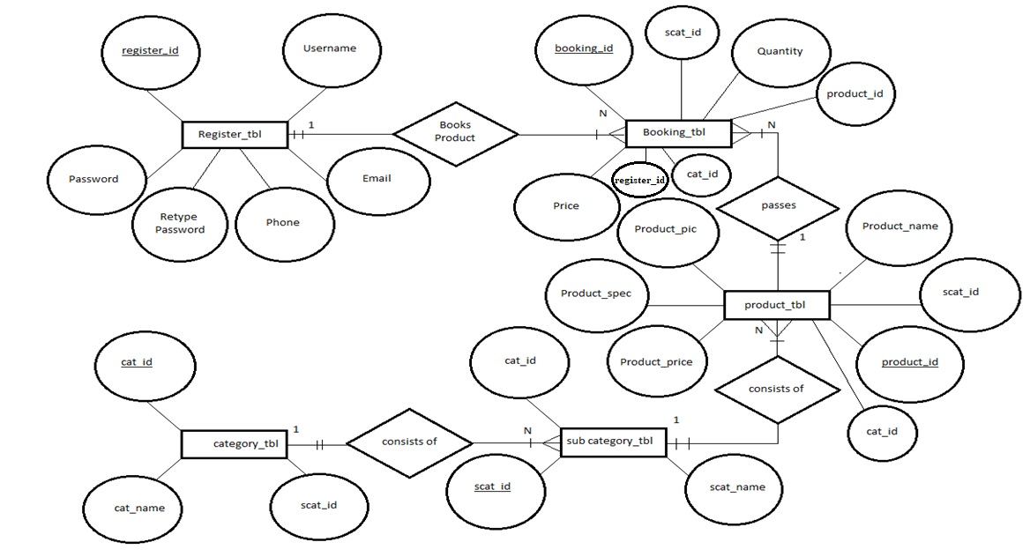
Entity Relationship Diagram

Slide 7
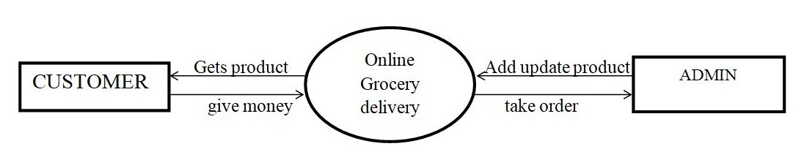
Data Flow Diagram-Level 0

Slide 8
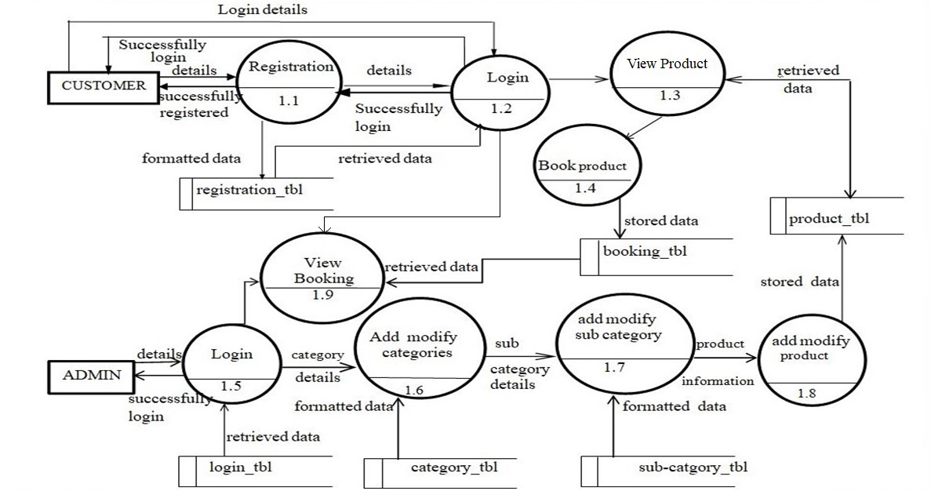
Data Flow Diagram-Level 1

Slide 9
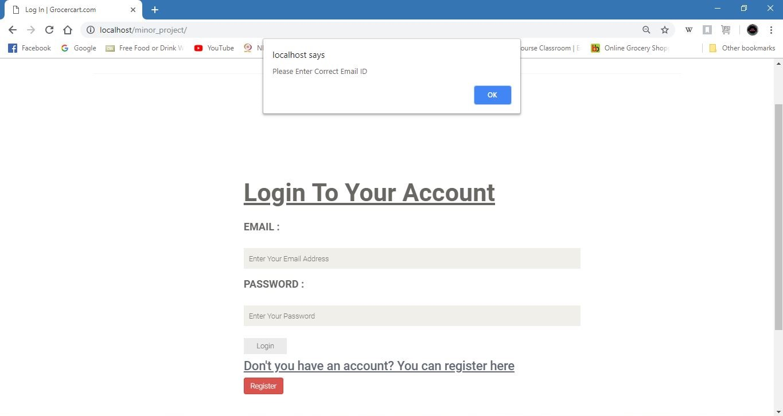
Screenshots/LogIn

Slide 10
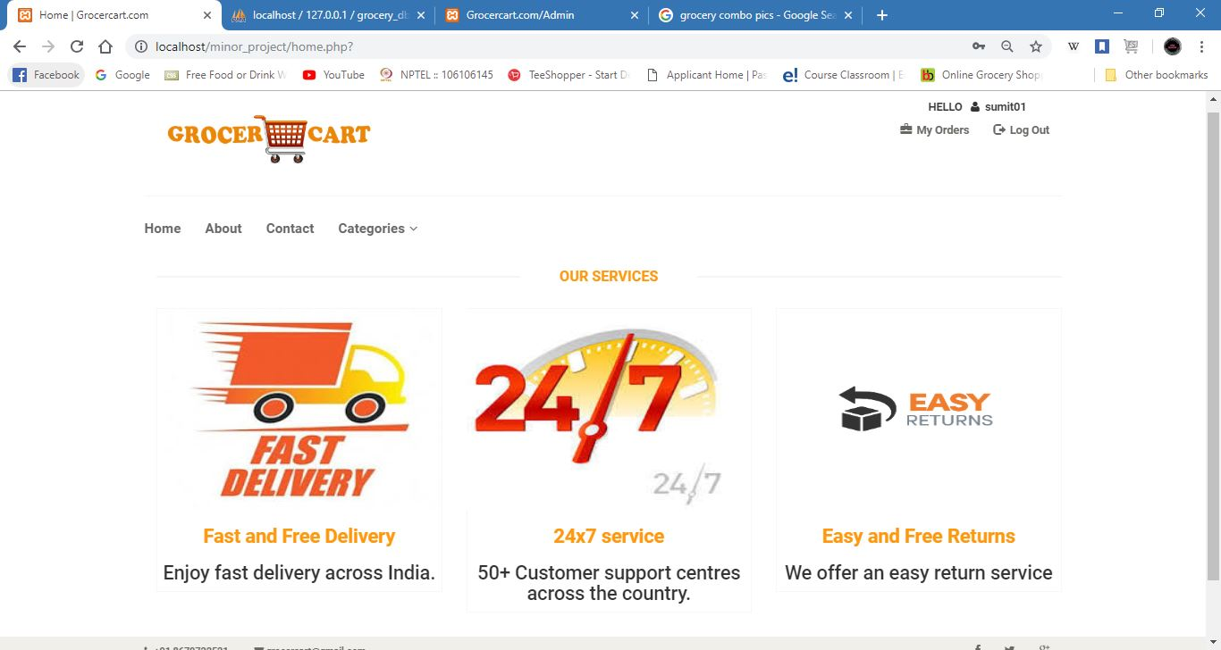
Screenshots/Home

Slide 11
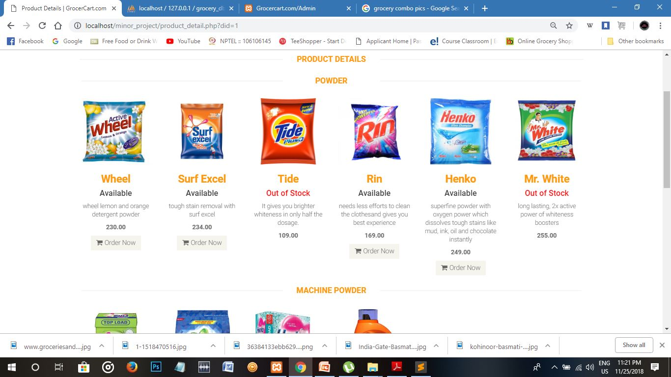
Screenshots/Products

Slide 12
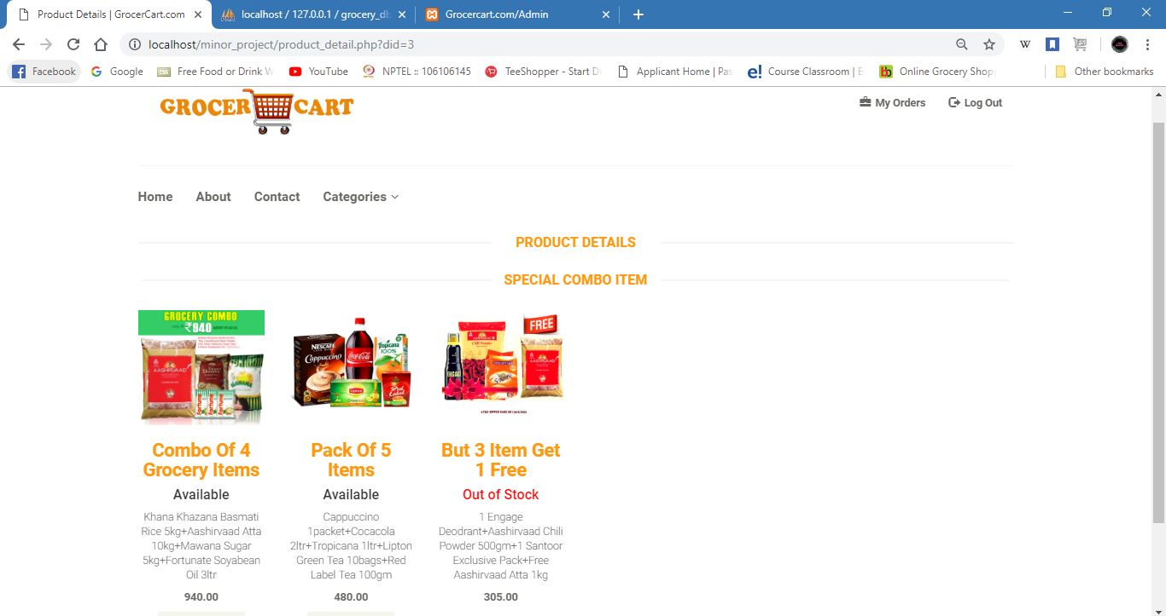
Screenshots/Products

Slide 13
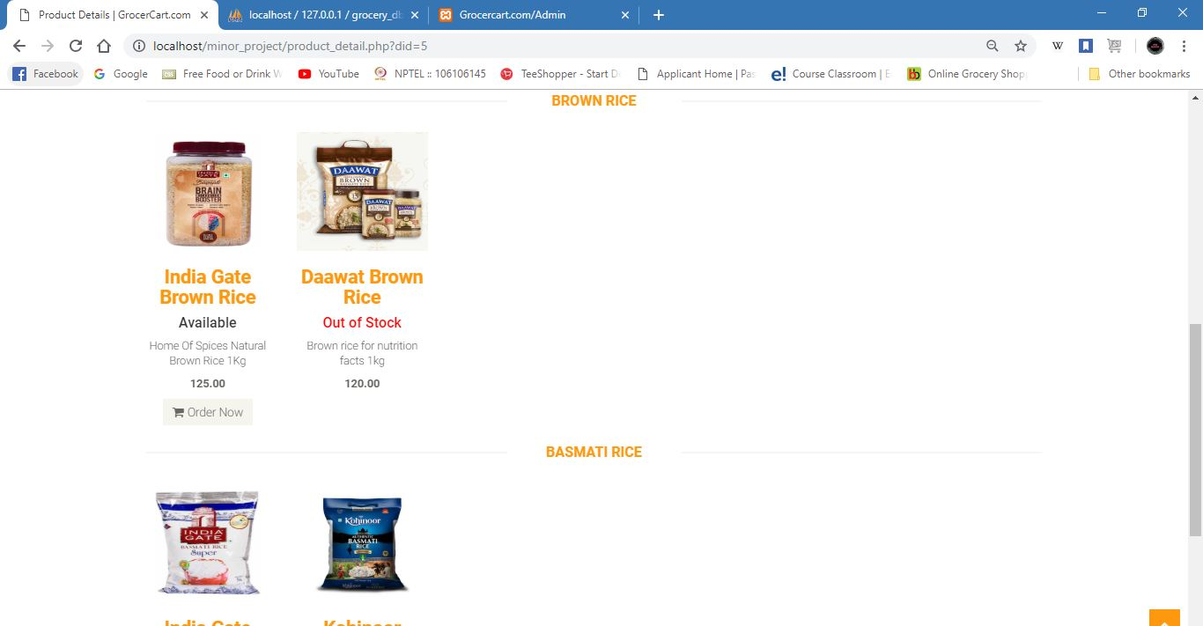
Screenshots/Products

Slide 14
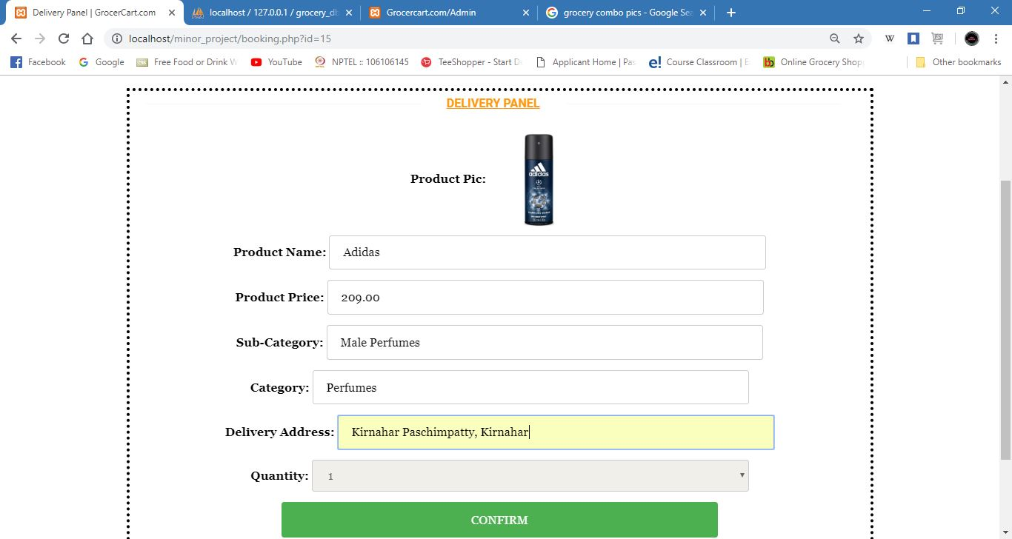
Screenshots/Booking

Slide 15
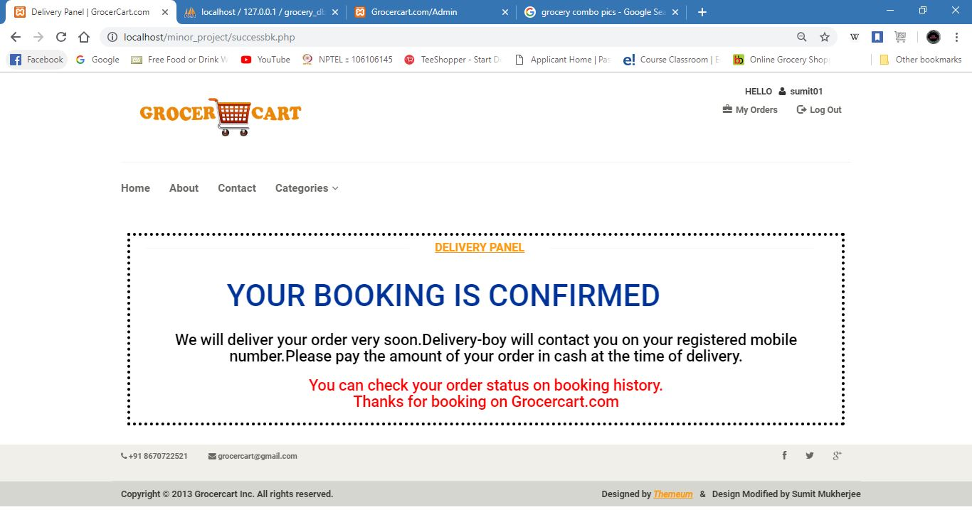
Screenshots/Complete Booking

Slide 16
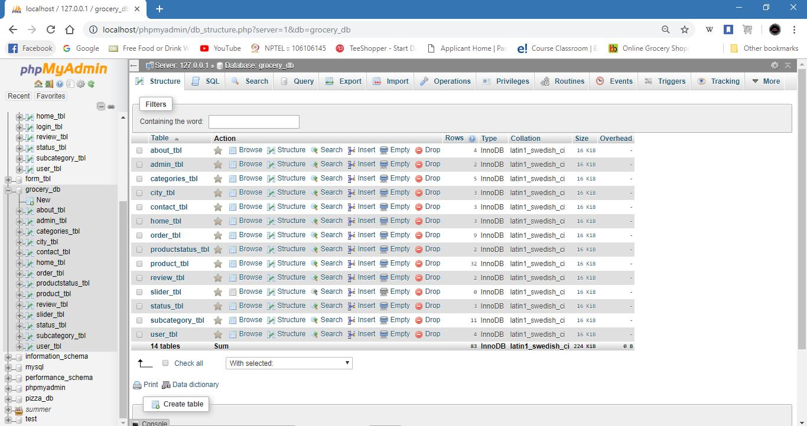
Screenshots/Database Tables

Slide 17
Application of The Project
Convenient: Online Grocery Shopping System is convenient. People don’t have to leave their homes to visit stores for Grocery Shopping. They can login to the internet, look for good products and then proceed to buy and order for their products.
Range of choices: It offers a great variety of options they usually have larger stocks of products than a physical store. Therefore, whatever products we need we can easily find it here.
Timesaving: We can save a lot of time and money by using Online Grocery Shopping System. People who live far from retail outlets and those with busy schedules can find this advantageous. They can buy multiple products at a minimum time.
Affordable: There are no middle men present between the customer and manufacturer. Customers buy products directly from the manufacturers. So, their products are considerably cheaper than those in local stores.

Slide 18
Advantages
Performance: Most of Operations and tasks in underlined system are repetitive and time consuming. So an efficient, effective system is desired.
Find everything you need: Search engines on websites makes it much easier to find items quickly by typing the name or the brand of the product.
Busy shops can be overwhelming: Other customers can sometime find shopping is an obstacle course. Shopping online saves all the hastle of navigating a busy supermarket.
Price checking and shipping is cheaper: In websites compared pieces of items against all the supermarkets helps the customer to find the best place to shop, deals and other promotions.
Disadvantages
Sometimes you cant get what you want: Companies will notify you if the product you need is out of stock after you have ordered. Most of the companies are trying to substitute your desired items for something of same quality and price.
Product Quality: Shopping online wont allow to check the qualities of your product.

Slide 19
Future Scope
There will be lot of scope to improve this project, since currently basic functionality would be provided.
Shopping Cart feature will be added to improve this minor project into a major project. So that, users can add multiple items into the cart and can checkout more than one product at one time.
Online payment method will be a great future scope of our project. Thus, consumers will be able to pay through Debit cards or e-wallets in online payment.
Some of the modules to improve are admin part such as personalized recommendations, discount & offer management. For customers, notification & messaging etc can be improved. These can be developed to make it more effective.
References
https://www.youtube.com https://www.themeum.com https://www.bigbasket.com https://www.w3schools.com
https://www.google.com

Slide 20
Conclusion
Online Food Delivery is the best way to purchase any item but be careful because there may be some fake products on different sites.
Only purchase those items which can be recognised easily that item is fake or not or choose according rating or reviews of buyers.
But not to worry, on our site Clickfood.com you will get all items genuine and trusty, just check once here before buy anywhere.
ClickFood.com
Spend For Quality

Slide 21
THANK YOU

